Slide 1
SpeCor Automatic Speech Recognition with Stutter and Lisp Correction
Under the Supervision of:
Dr. Manal Mohsen Tantawi
T.A Manar Sultan

Slide 2
Members
01
Abdelrahman Fakhry Hussein
02
Basma Ahmed Sayed
03
Eman Bassem Ezzat
04
Mohammed Mahmoud Hassan
Mohamed Abdelmonem Abdelrahman
Tarek Abo Elenen Ali
05
06

Slide 3
Agenda
01
Problem Definition
08
Results & Analysis
02
Motivation
09
Demo
03
Objectives
10
Conclusion
04
Related Works
11
Future Work
05
System Architecture
06
Preprocessing
07
Model

Slide 4
PROBLEM DEFINITION

Slide 5
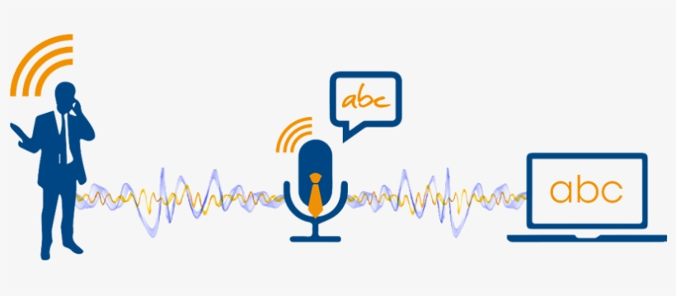
SpeCor
Many people struggle with speech impediments and accented speech. Therefore, we thought of addressing this issue by converting the speech within the audio recording into accurate, error-free text.
Additionally, the voice of the person who recorded the audio can be retained and the generated text can be transformed back into an audio recording with the same voice as that person.

Slide 6
MOTIVATION

Slide 7
Motivation
The motivation stems from the need to make voice-based communication more inclusive and accessible for individuals with speech impediments.
Traditional Automatic Speech Recognition systems often struggle to accurately transcribe speech that includes these characteristics, leading to frustration and limited usability for affected individuals.
By addressing this challenge, we aim to empower individuals with speech impediments to communicate more effectively and participate fully in various domains of life.

Slide 8
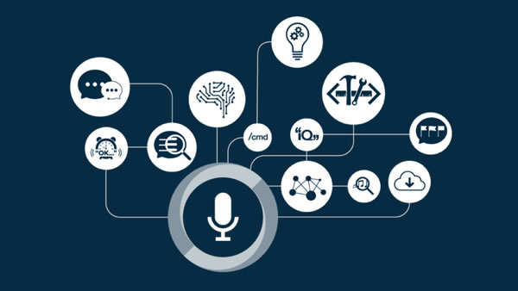
Important Applications Examples
Improving Communication
Accessibility
Language Learning
Content Creation

Slide 9

Improving Communication
Helps individuals with speech impediments such as lisps or stutters to communicate more effectively, reducing potential barriers and misunderstandings.

Slide 10
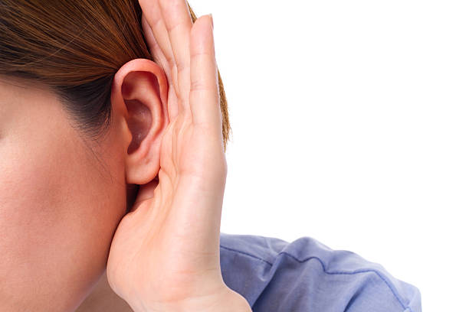
Accessibility
Enhances accessibility for individuals with hearing impairments by providing accurate transcriptions of spoken content.

Slide 11
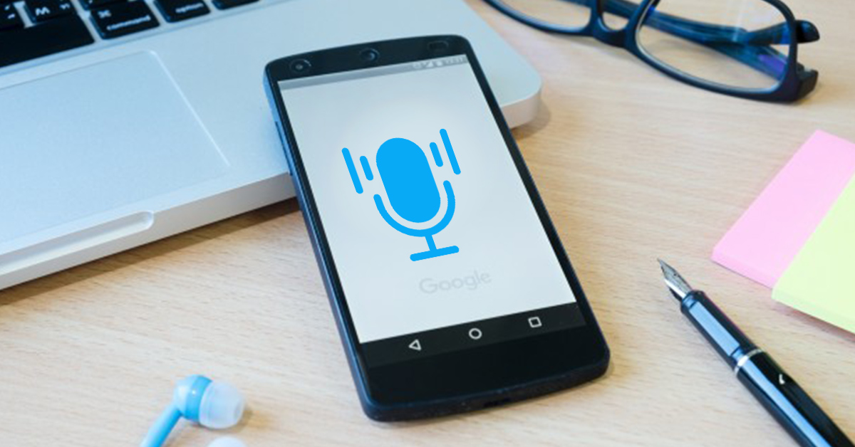
Language Learning
Language learners can benefit from accurate text transcriptions of spoken language, aiding in pronunciation and comprehension.

Slide 12
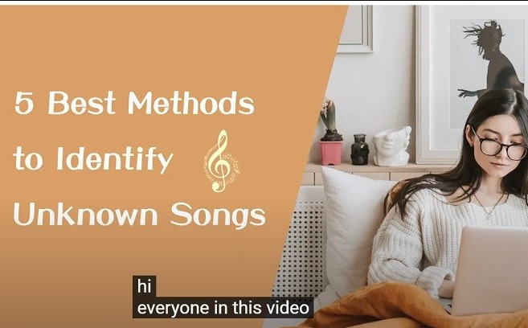
Content Creation
Facilitates content creation for podcasts, video captions, and other media by automatically generating text from audio recordings.

Slide 13
OBJECTIVES

Slide 14
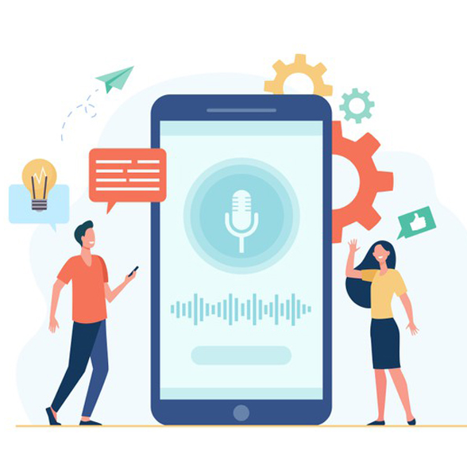
Objectives
Develop an Automatic Speech Recognition system:
Takes speech and converts it into transcription text.
Recognizes speech.
Corrects speech with lisps and stuttering in real-time.
Enhances the accessibility and inclusivity of the technology by providing accurate transcriptions for individuals with speech impediments.

Slide 15
RELATED WORKS

Slide 16
Reference | Dataset | Preprocessing | Feature Extraction | Model | Evaluation
[1] (2023) | LibriSpeech Aishell-1 WenetSpeech | Down sampling Normalization Log-Scaling | Spectrogram / Mel-Spectrogram | ZIPFORMER E-Branchformer Conformer SqueezeFormer | WER (ZIPFORMER) = 4.38 WER (E-Branchformer) = 4.55 WER (Conformer) = 5.55 WER (SqueezeFormer) = 5.97
[2] (2023) | Common Voice Corpus L2-ARCTIC | Normalization Log-Scaling Codebook Mapping (Discretization) | Spectrogram / Mel-Spectrogram | Codebook Attend DAT MTL | WER (Codebook Attend) = 18.2 WER (DAT) = 18.7 WER (MTL) = 18.9
[3] (2023) | Multi-Genre Broadcast QASR corpus Arabic Speech Corpus Classical Arabic Text-to-Speech Corpus | Punctuation Marks Removal Audio Sampling | Mel-Frequency Cepstral Coefficients Log Mel-filter banks | ArTST SpeechT5 | WER (ArTST) = 17.27% WER (SpeechT5) = 53.19% CER (ArTST) = 9.99% CER (SpeechT5) = 19.01%
[4] (2022) | LibriSpeech MuST-C: a Multilingual Speech Translation Corpus CoVoST-2 : a Large-Scale Multilingual Speech-To-Text Translation Corpus | Data Normalization Speed Perturbation Sequence Alignment Data Transformation | Log Mel-filter banks | FAIRSEQ S2T | BLEU = 21.14 WER = 3.7
[5] (2022) | LibriSpeech MUST-C WSJ0 Hipster Ambient Mixtures VoxCeleb1 | Background Noise Removal | Log Mel-filter banks | SpeechT5 Wav2Vec HuBERT SUPERB SpeechNet | WER (SpeechT5) = 5.8 WER (Wav2Vec) = 6.3 WER (HuBERT) = 8.1 SID (SpeechT5) = 96.49% SID (SUPERB) = 90.33% SID (SpeechNet) = 87.9%
[6] (2022) | Aishell-1 Aidatatang | Sequence Alignment | Mel-Frequency Cepstral Coefficients Log Mel-filter banks | SoftCorrect Rescore FastCorrect | CER Reduction = 26.1 and 9.4
G

Slide 17
Reference | Dataset | Preprocessing | Feature Extraction | Model | Evaluation
[7] (2022) | TED-LIUM3 Earnings-21 Meanwhile CORAAL | Audio Resampling Feature Extraction Feature Normalization | Mel Spectrograms | Whisper | WER = 11.3
[8] (2022) | Common Voice Corpus | Data Augmentation | Mel-Frequency Cepstral Log Mel-filter banks | RoBART Wav2Vec | WER = 34.45
[9] (2021) | DARPA TIMIT Corpus Wall Street Journal Corpus | Feature Extraction Data Augmentation | Mel Spectrograms Mel-Frequency Cepstral Coefficients | MixSpeech SpecAugment Listen, Attend, and Spell | PER = 10.6 WER = 4.7
[10] (2021) | CLC FCE Google ngram | Pre-Tokenization Word Embeddings Positional Encoding CLS Token Representation | Extra CLS Token | BERT GNU-ASPELL SDA | Top-N Accuracy Metrics = 73.25%
[11] (2021) | Aishell-1 | Pre-Tokenization Word Embeddings Positional Encoding Self-Attention Mechanism | Extra Positional Encoding | FastCorrect FELIX LevT | WER = 4.16 WER Reduction = 8.06
[12] (2021) | NA | Analog-To-Digital Conversion Feature Extraction Feature Selection | Mel Frequency Cepstral Coefficients Linear Predictive Coding Coefficients | Hidden Markov Model Artificial Neural Network Classier-Based Cuckoo Search Optimization | NA
G

Slide 18
Reference | Dataset | Preprocessing | Feature Extraction | Model | Evaluation
[13] (2020) | LibriSpeech | Feature Extraction | Log Mel-filter banks | Transformer-based ASR model CAPIO LSTM | WER = 12.9
[14] (2020) | LibriSpeech | Pre-Audio Sampling Noise Reduction Silence Removal | Mel-Frequency Cepstral Log Mel Spectrogram | Conformer ContextNet Listen, Attend, and Spell QuartzNet | WER (Conformer) = 3.9 WER (ContextNet) = 4.1 WER (LAS) = 5.17 WER (QuartzNet) = 7.25
[15] (2020) | LibriSpeech Europarl TIMIT Corpus | Data Augmentation Data Normalization Speed Perturbation | Mel-Frequency Cepstral Coefficients | KALDI AST | BLEU = 10.3 WER = 22.5 – 80.5
[16] (2019) | LibriSpeech Wall Street Journal Corpus | Data Normalization Short-Time Fourier Transform (STFT) Power Spectrogram | Mel-Spectrogram | Jasper | WER = 3.86
[17] (2018) | Manually Collected | Feature Extraction Feature Selection | Mel-Frequency Cepstral Coefficients Linear Predictive Cepstral Coefficient Linear Discriminant Analysis | Hidden Markov Model Support Vector Machine | Accuracy = 86%
[18] (2015) | Switchboard Wall Street Journal Corpus | Feature Extraction Feature Selection | Linear Discriminant Analysis Feature-space Maximum Likelihood Linear Regression | Kaldi EESEN | WER (Kaldi) = 7.14 WER (EESEN) = 7.87
G

Slide 19
Comments
The Most Popular Datasets Used:
LibriSpeech
Common Voice Corpus
Wall Street Journal
Aishell-1
Most of the papers are void of preprocessing techniques, but the most frequent besides feature extraction are Data Augmentation and Data Normalization.
The Most Commonly Used Feature Extraction Technique is Mel-Frequency Cepstral Coefficients.
The Suitable Evaluation Metrics for Speech Recognition are Word Error Rate and Character Error Rate.

Slide 20
SYSTEM ARCHITECTURE

Slide 21

System Architecture

Slide 22
Datasets
The chosen datasets for the project are:
LibriStutter
LibriSpeech

Slide 23
LibriStutter
Specifications:
Contains stuttered English speech, time-aligned transcriptions, and 5 stuttering types.
Contains 20 hours of audio selected from the “clean” speech of LibriSpeech.
Reasons:
Has a suitable size of 10 GB.
Contains stuttered speech which is one of the core targets in the project.
Includes transcripts.

Slide 24
LibriSpeech
Specifications:
Contains English speech and time-aligned transcriptions.
Contains 100 hours of clean speech.
Reasons:
Has a suitable size of 6.3 GB.
Large-scale and high-quality speech corpus.
Includes transcripts with timestamps.

Slide 25
PREPROCESSING

Slide 26
Preprocessing
Following the trend of recent works in taking a minimalist approach towards preprocessing.
Data augmentation is used to improve training.
By adding noise to the data to challenge the model to handle it and provide a more realistic representation of the subject.
To provide real-time Speech-To-Text conversion, by reducing the time needed to remove background noise.
In real-life conversations, it is very rare for there to be no noise, and the sound is rarely 100% clear.

Slide 27


Preprocessing
Original Audio
Noise
Noisy Audio
Notes:
Noise is Air Conditioner Noise

Slide 28
Feature Extraction
Mel-Frequency Cepstral Coefficients (MFCC) will be used.
The process of computing MFCC involves several steps:
Pre-emphasis
Windowing
Fast Fourier Transform
Log Mel Filter Bank
Discrete Cosine Transform

Slide 29
MODEL

Slide 30
Model
Using Whisper, a general-purpose sequence-to-sequence automatic speech recognition model, receives the speech as input and displays the transcription of the speech.
The model has shown remarkable effectiveness in enhancing Automatic Speech Recognition capabilities.

Slide 31
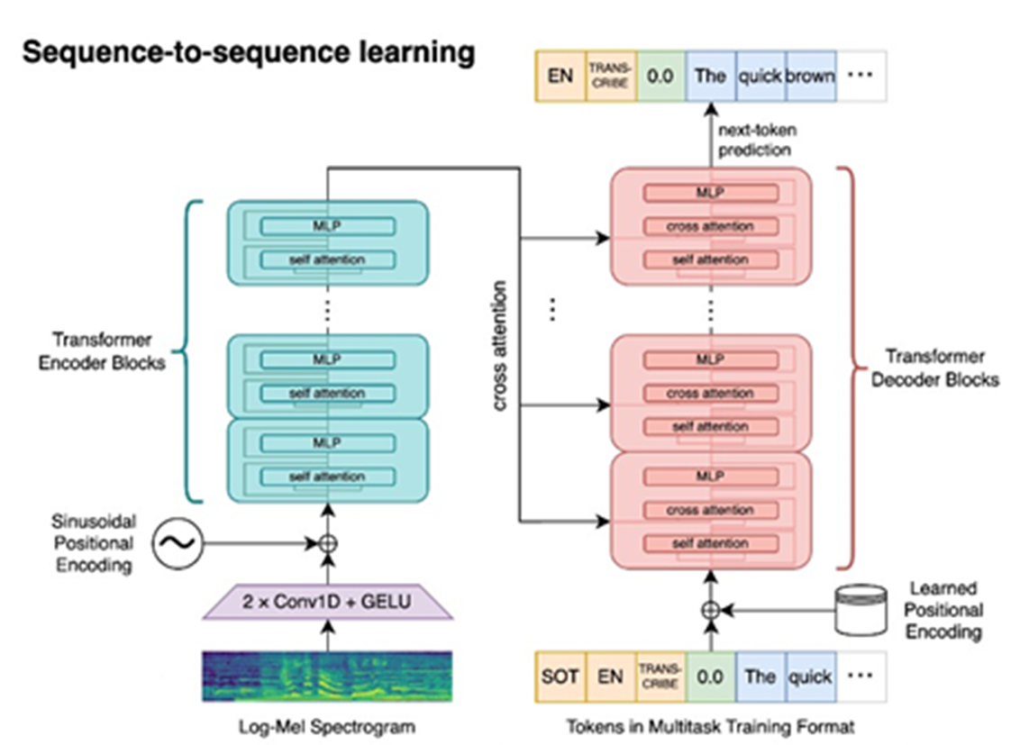
Model Architecture

Slide 32
How it works
Uses KV-Cache which saves previous keys and values (weights) improving performance and reducing calculations.
Uses a tokenizer to encode the text into tokens and decode them back.
Utilizes temperature, an option used to make the model more stochastic, when calculating the probabilities of the words.
Decodes using Greedy decoder or Beam Search decoder.

Slide 33
RESULTS & ANALYSIS

Slide 34

Evaluation
Word Error Rate:
Word Error Rate is a valuable metric for assessing and comparing the performance of ASR systems, making it a widely accepted and practical tool in developing and evaluating speech recognition technology.
Formula:
$$\frac{No. Substitution+No. Deletion+No. Insertion}{N}$$
Substitutions - Words that were recognized incorrectly.
Deletions - Words from the reference that were not recognized.
Insertions - Extra words that were incorrectly added in the recognition.
N - Total number of words in the reference transcription.

Slide 35

Evaluation Example
Formula:
$$\frac{No. Substitution+No. Deletion+No. Insertion}{N}$$
Reference Transcription Text:
I going
the
park
am
to
Now
I going
Model Transcription Text:
too
bark
finally at last
Deletion Error
Insertion Error
WER = $\frac{4 +2 +2}{6}$ = 1.3333 = 133.33%
Substitution Error

Slide 36
Results Using WER
 | LibriSpeech | LibriStutter
Using LibriSpeech Only | 8.3% | 95.5%
Using LibriStutter Only | 445.39% | 212.05%
Using LibriSpeech & LibriStutter | 9.24% | 16%
Test
Train

Slide 37
Comparison Using WER
 | LibriSpeech
Radford et al. [7] using LibriSpeech | 8.3%
Using LibriSpeech & LibriStutter | 9.24%
Test
Authors

Slide 38
Analysis & Comments
Training using LibriSpeech Only
Achieved the best accuracy for the LibriSpeech dataset.
The model is well-trained in non-stuttered speech.
Huge disparity between the accuracies achieved between stuttered and non-stuttered datasets.
Could lead to discrimination against individuals with speech impediments.

Slide 39
Analysis & Comments
Training using LibriStutter Only
Achieved the worst accuracy for both datasets it was tested on.
The model is not well-trained in either stuttered or non-stuttered speech.
More biased to stuttered speech than non-stuttered.

Slide 40
Analysis & Comments
Training using LibriSpeech & LibriStutter
By combining both datasets and fine-tuning the hyperparameters while training.
Improved the accuracy of the model towards stuttered speech.
Although the accuracy decreased for the LibriSpeech dataset, it traded off with the accuracy of the LibriStutter dataset.
Achieved desirable results for both datasets, which included stuttered and non-stuttered speech.

Slide 41
Analysis & Comments
During training, the model was trained on both LibriSpeech and LibriStutter datasets and fine-tuned the used hyperparameters.
As LibriStutter has speech difficulties due to the domain-specific language that is being used.
LibriSpeech is much broader and more general in terms of the vocabulary being used.
Combining both datasets provides both the extensive vocabulary of LibriSpeech and speech impediments included in LibriStutter.

Slide 42
DEMO

Slide 43
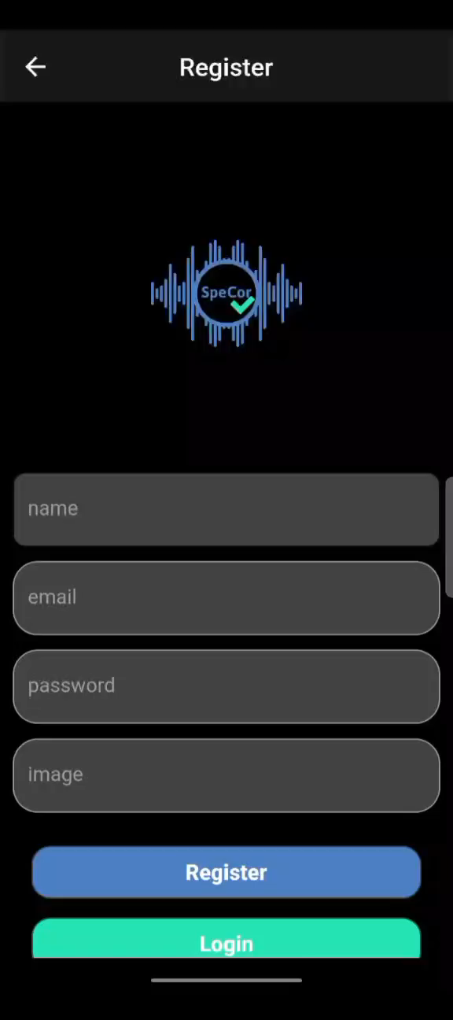

Slide 44
CONCLUSION

Slide 45
Conclusion
SpeCor aims to improve communication by providing accurate transcriptions, increasing accessibility for individuals with hearing or speech impairments.
The system addresses the critical challenges of accurately transcribing speech impediments which is essential for making ASR technology more reliable and inclusive.
The system integrates advanced deep learning algorithms trained on diverse datasets, enabling it to recognize and correct errors associated with speech impediments and accents.

Slide 46
FUTURE WORK

Slide 47
Future Work
Text-to-speech feature using the sender’s voice through the development of a zero-shot speech synthesis model.
Train on more datasets containing a variety of speech impediments to be more inclusive.
Train using more powerful resources.

Slide 48
REFERENCES

Slide 49
References
[1] Z. Yao, L. Guo, X. Yang, W. Kang, F. Kuang, Y. Yang, Z. Jin, L. Lin, and D. Povey. “ZIPFORMER: A FASTER AND BETTER ENCODER FOR AUTOMATIC SPEECH RECOGNITION,” in arXiv, https://arxiv.org/abs/2310.11230 (2023).
[2] D. Prabhu, P. Jyothi, S. Ganapathy, and V. Unni. “Accented Speech Recognition With Accent-specific Codebooks,” in arXiv, https://arxiv.org/abs/2310.15970v3 (2023).
[3] H. O. Toyin, A. Djanibekov, A. Kulkarni, H. Aldarmaki. “ArTST: Arabic Text and Speech Transformer,” in arXiv, https://arxiv.org/abs/2310.16621v1 (2023).
[4] C. Wang, Y. Tang, X. Ma, A. Wu, S. Popuri, D. Okhonko, and J. Pino. “fairseq S2T: Fast Speech-to-Text Modeling with fairseq,” in arXiv, https://arxiv.org/abs/2010.05171 (2022).
[5] J. Ao, R. Wang, L. Zhou, C. Wang, S. Ren, Y. Wu, S. Liu, T. Ko, Q. Li, Y. Zhang, Z. Wei, Y. Qian, J. Li, and F. Wei. “SpeechT5: Unified-Modal Encoder-Decoder Pre-Training for Spoken Language Processing,” in arXiv, https://arxiv.org/abs/2110.07205 (2021).
[6] Y. Leng, X. Tan, W. Liu, K. Song, R. Wang, X.-Y. Li, T. Qin, E. Lin, And T.-Y. Liu. “SoftCorrect: Error Correction with Soft Detection for Automatic Speech Recognition,” in arXiv, https://arxiv.org/abs/2212.01039 (2022).

Slide 50
References
[7] A. Radford, J. W. Kim, T. Xu, G. Brockman, C. McLeavey, I. Sutskever. “Robust Speech Recognition via Large-Scale Weak Supervision,” in arXiv, https://arxiv.org/abs/2212.04356 (2022).
[8] S. Dutta, S. Jain, A. Maheshwari, S. Pal, G. Ramakrishnan, and P. Jyothi. “Error Correction in ASR using Sequence-to-Sequence Models,” in arXiv, https://arxiv.org/abs/2202.01157 (2022).
[9] L. Meng, J. Xu, X. Tan, J. Wang, T. Qin, and B. Xu. “MIXSPEECH: DATA AUGMENTATION FOR LOW-RESOURCE AUTOMATIC SPEECH RECOGNITION,” in arXiv, https://arxiv.org/abs/2102.12664 (2022).
[10] Y. Hu, X. Jing, Y. Ko, and J. T. Rayz. “Misspelling Correction with Pre-trained Contextual Language Model,” in arXiv, https://arxiv.org/abs/2101.03204 (2021).
[11] Y. Leng, X. Tan, L. Zhu, J. Xu, R. Luo, L. Liu, T. Qin, X.-Y. Li, E. Lin, and T.-Y. Liu. “FastCorrect: Fast Error Correction with Edit Alignment for Automatic Speech Recognition,” in arXiv, https://arxiv.org/abs/2105.03842 (2021).
[12] O. Basystiuk, N. Shakhovska, V. Bilynska, O. Syvokon, O. Shamuratov, and V. Kuchkovskiy. “The Developing of the System for Automatic Audio to Text Conversion,” in ceur-ws, https://ceur-ws.org/Vol-2824/, Paper 1, (2018)

Slide 51
References
[13] A. Mohamed, D. Okhonko, and L. Zettlemoyer. “Transformers with convolutional context for ASR,” in arXiv, https://arxiv.org/abs/1904.11660 (2020).
[14] A. Gulati, J. Qin, C.-C. Chiu, N. Parmar, Y. Zhang, J. Yu, W. Han, S. Wang, Z. Zhang, Y. Wu, and R. Pang. “Conformer: Convolution-augmented Transformer for Speech Recognition,” in arXiv, https://arxiv.org/abs/2005.08100 (2020).
[15] M. C. Stoian, S. Bansal, and S. Goldwater. “Analyzing ASR pretraining for low-resource speech-to-text translation,” in arXiv, https://arxiv.org/abs/1910.10762 (2020).
[16] J. Li, V. Lavrukhin, B. Ginsburg, R. Leary, O. Kuchaiev, J. M. Cohen, H. Nguyen, and R. T. Gadde. “Jasper: An End-to-End Convolutional Neural Acoustic Model,” in arXiv, https://arxiv.org/abs/1904.03288 (2019)
[17] A. Dash, N. Subramani, T. Manjunath, V. Yaragarala, and S. Tripathi. “Speech Recognition and Correction of a Stuttered Speech,” in e-tarjome, https://e-tarjome.com/storage/panel/fileuploads/2022-07-06/1657094472_e16845.pdf (2019)
[18] Y. Miao, M. Gowayyed, and F. Metze. “EESEN: End-to-End Speech Recognition using Deep RNN Models and WFST-based Decoding,” in arXiv, https://arxiv.org/abs/1507.08240v3 (2015)

Slide 52
Any Questions?

Slide 53
THANK YOU

